Slide 1
Challenge 1: Predict Kinase Selectivity Using Machine Learning (Molecular Forecaster)
Team: Hack the Pharma
Presenters: Swagat, Allena, Maria, Kini

Slide 2
Overview
Background
Data Processing Pipeline
Models and Training
Evaluation Metrics
PERFORMANCE ON NEW TEST SET
Results
Discussion

Slide 3
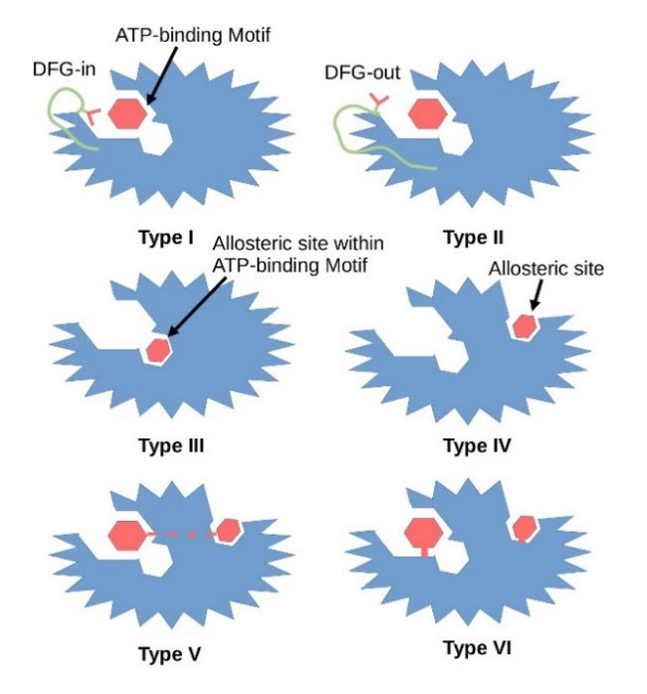
Background
Notes:
(Image) Inhibitors for Cyclin-dependent kinases
Kinase: A type of enzyme (a protein that speeds up chemical reactions in the body) that adds chemicals called phosphates to other molecules, such as sugars or proteins.
Inhibitors: Enzyme inhibitors are molecules that interact with enzymes (temporary or permanent) in some way and reduce the rate of an enzyme-catalyzed reaction or prevent enzymes to work in a normal manner.

Slide 4
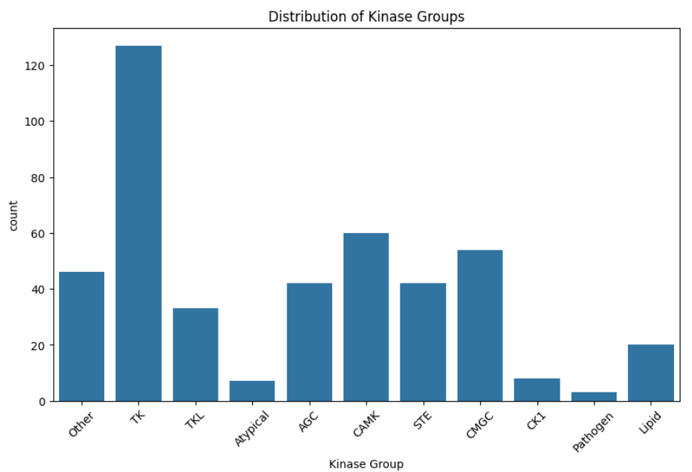
Kinase selectivity prediction
Kinase Families
Many kinase inhibitors exhibit off-target activity:
toxicity and side effects (binding to unintended kinases),
lack of efficacy (non-selective inhibitors may engage multiple kinases reducing therapeutic precision)
drug resistance (off-target interactions can activate compensatory signaling pathways).
Selectivity scores quantify how specifically inhibitors target kinases
Notes:
Overview of the problem pt. 1: Key components of kinase selectivity prediction

Slide 5
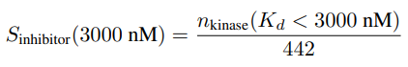
K_{d} and Selectivity Score
K_{d}: Dissociation constant that measure inhibitor-kinase interactions
K_{d} → affinity
Selectivity Score:
Higher n = S closer to 1 = lower selectivity because the inhibitor can bind to many kinases
Lower n = S closer to 0 = higher selectivity because the inhibitor can bind to only few kinases (very specific, highly selective).
Notes:
Overview of the problem pt. 2: Key components of kinase selectivity prediction
Interpreting the Selectivity Score SSS
If SSS is closer to 1 → The inhibitor binds to many kinases → Low selectivity (more promiscuous)
If SSS is closer to 0 → The inhibitor binds to few kinases → High selectivity (more specific)
Relationship Between nnn and Selectivity
Since SSS and nnn are directly proportional, a higher nnn (more kinases bound) results in a higher SSS, which means lower selectivity.
Higher SSS (closer to 1) → Lower selectivity → The inhibitor is binding to many kinases (not specific).
Lower SSS (closer to 0) → Higher selectivity → The inhibitor binds to only a few kinases (very specific).

Slide 6
Final Goal
The ML model predicts kinase selectivity profile of inhibitors.
The goal is to rank kinases based on their likelihood of being inhibited by a given compound.
We use regression to predict the exact equilibrium dissociation constant (K_{d}). Then, we calculate the selectivity scores (S) using their earlier predictions and the given formula.
Notes:
Do we keep this slide?

Slide 7
Our Solution
This codebase implements a comprehensive machine learning pipeline for predicting kinase inhibitor binding affinities and selectivity profiles. The system utilizes deep learning with protein and chemical structure embeddings to tackle three key tasks:
Regression: Predict exact Kd values for kinase-inhibitor pairs
Classification: Predict whether compounds bind kinases below 300nM or 3000nM thresholds
Selectivity Prediction: Estimate compound selectivity across the kinome
The implementation employs cross-validation, data caching, and multiple evaluation metrics to ensure robust performance assessment.

Slide 8
Data Processing Pipeline
Raw Data → Preprocessing → Feature Extraction → Model Training → Evaluation

Slide 9
Preprocessing
The code processes three primary datasets:
kd_matrix.csv: Contains binding affinity (Kd) values between compounds and kinases
compounds.csv: Contains compound metadata including SMILES structures
kinases.csv: Contains kinase metadata including accession numbers
Key preprocessing steps:
Log-transformation of Kd values for regression
Binary classification labels at 300nM and 3000nM thresholds
Selectivity score calculation (S_300, S_3000) for each compound

Slide 10
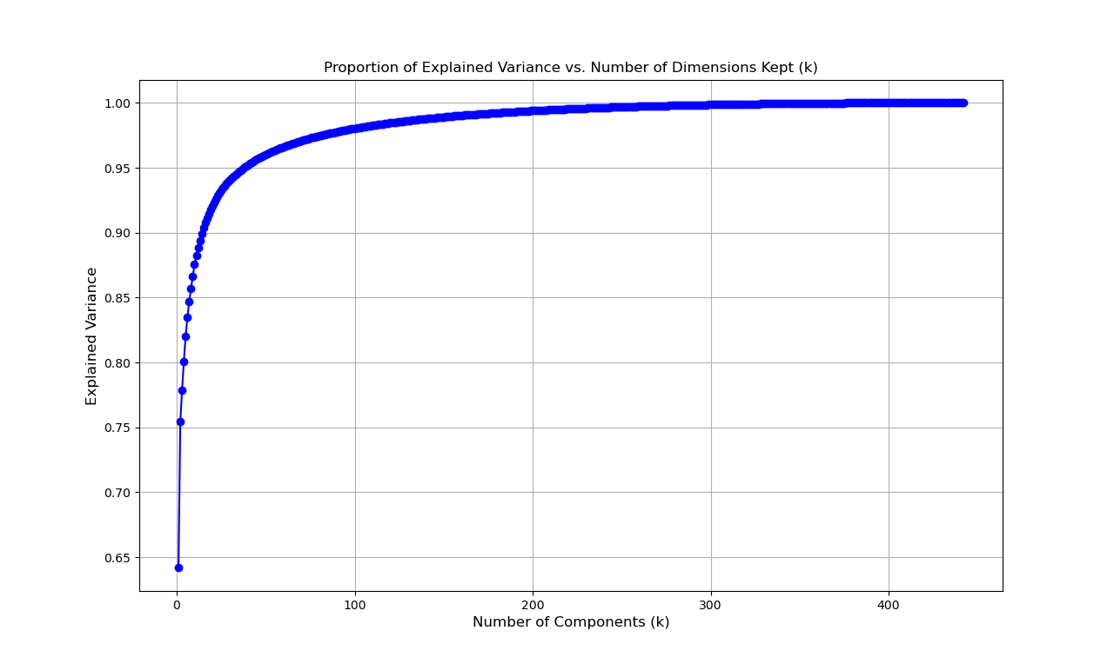
Dataset Handling and Tools
Dataset Handling:
SMILES strings, molecular fingerprint (RDKit), protein embedding (dimension reduction using SVD)
Tools:
RDKit, ChemBERTa
Notes:
•Strategy and Solution: How clearly your team defines a strategy to predict kinase selectivity, whether through regression or classification, and how you plan to handle the dataset (e.g., using SMILES strings, molecular fingerprints, or protein embeddings).
•Explanation and Justification: How effectively your team communicates the chosen approach, ensuring it is clear, complete, and well-justified. This includes explaining why specific machine learning models, tools (e.g., RDKit, ChemBERTa, ProteinBERT), or evaluation metrics (e.g., MSE, MAE, Zero-One Loss) were selected.

Slide 11
Feature Extraction
The system employs state-of-the-art representation learning:
Protein Features (Kinases):
ProtBERT embeddings from protein sequences fetched via NCBI
CLS token representation as sequence embedding
Chemical Features (Compounds):
ChemBERTa embeddings from SMILES strings
Multiple fingerprint types (ECFP4, ECFP6, MACCS keys)
Concatenation of embeddings and fingerprints for rich representation

Slide 12
Models and Training

Slide 13
ML Models
Linear regression:
It serves as a baseline model to compare against more complex approaches. Helps identify whether a simple linear relationship exists in the data. Fast and interpretable, making it easy to analyze feature importance.
XGBoost:
Handles non-linear relationships well, making it a great improvement over Linear Regression. Uses gradient boosting, which iteratively improves performance. Efficient with large datasets and handles missing data effectively.
Random Forest:
Reduces overfitting compared to a single decision tree by averaging multiple models. Works well with both linear and non-linear relationships. More interpretable than XGBoost, making it useful for understanding feature importance.
Notes:
- Used same train-test data subsets for all models to ensure a fair comparison of the models and reproducibility

Slide 14
Baseline Model
Linear Regression with XGBoost – This provides a simple benchmark to compare against more complex models.
We used XGBoost to enhance traditional linear regression, making it more robust while still serving as a simple reference model.

Slide 15
Ensemble Model
XGBoost – A powerful gradient boosting algorithm that builds multiple decision trees sequentially, correcting errors at each step to improve accuracy.
Random Forest – Uses multiple decision trees trained on random subsets of the data and averages their predictions to improve stability and reduce overfitting.
K-Nearest Neighbor – A distance-based algorithm that predicts outcomes by considering the 'k' closest data points, making it useful for capturing local patterns.

Slide 16
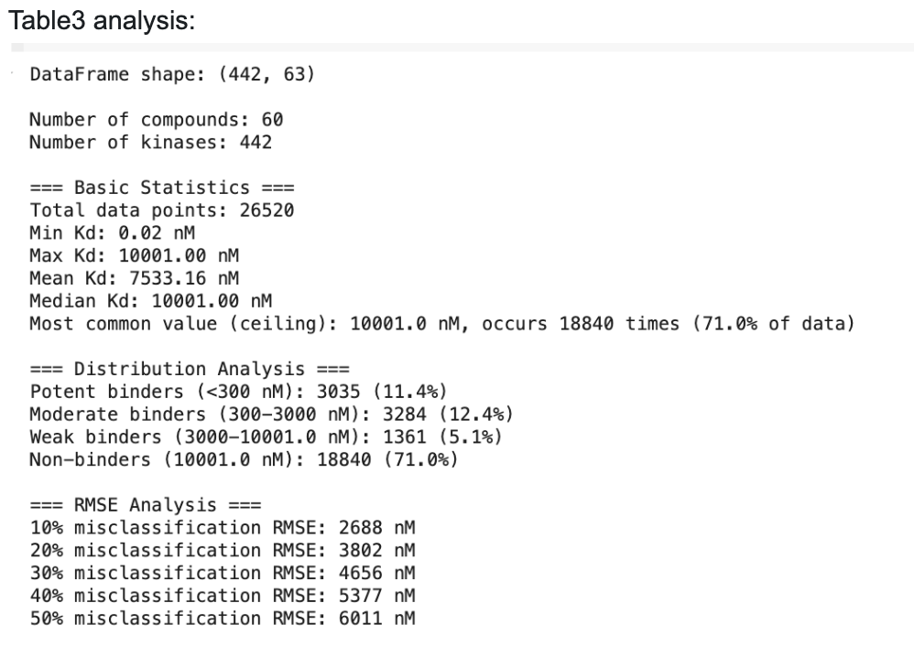
Notes:
- Used same train-test data subsets for all models to ensure a fair comparison of the models and reproducibility

Slide 17
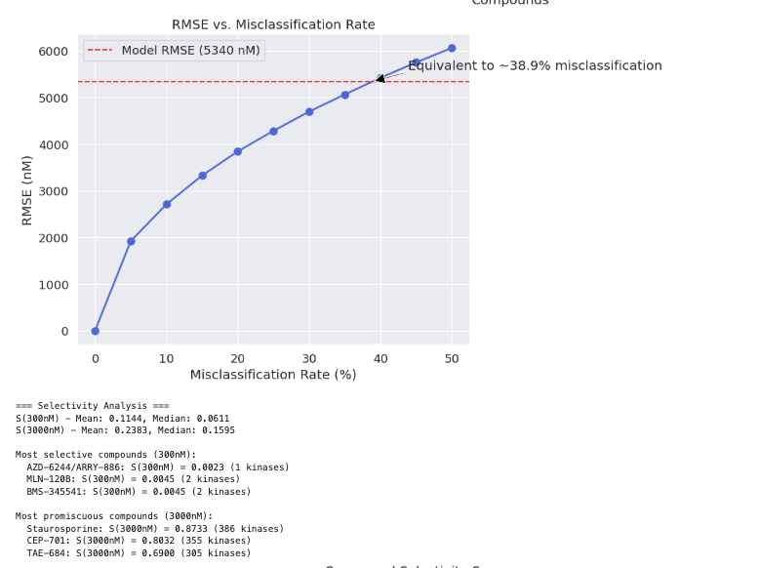

Slide 18
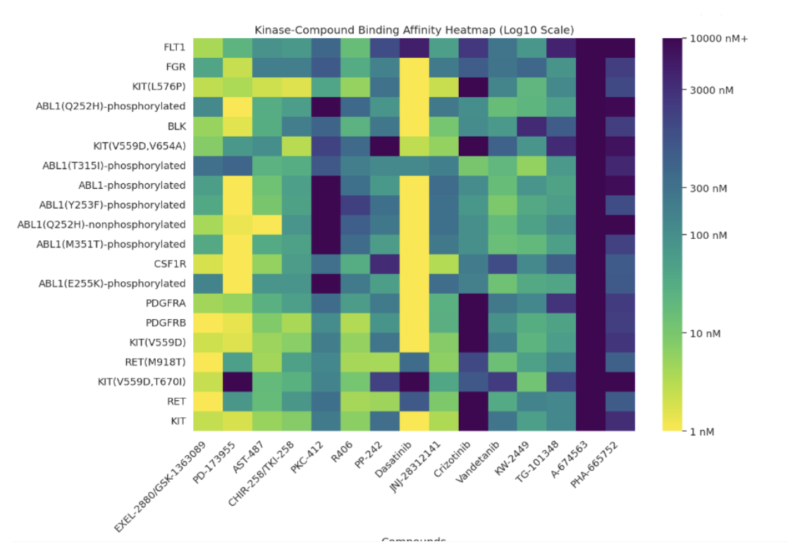

Slide 19
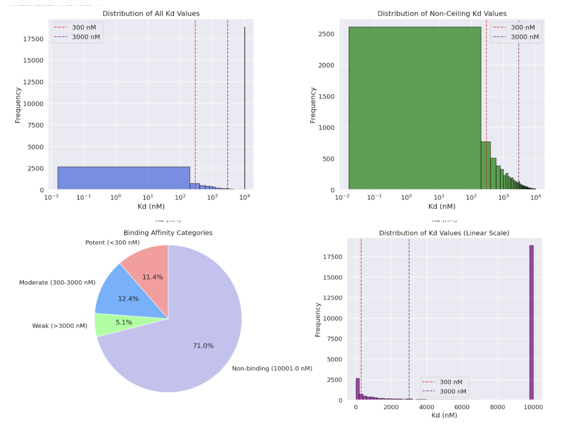

Slide 20
Example Exploration: K-Nearest Neighbors Regression (KNN)
Description: KNN regression predicts the target value by averaging the targets of the nearest neighbors. It’s a simple and interpretable model, but computationally expensive for large datasets.
Why it's good: KNN can capture non-linear relationships, making it useful for biological data where the relationship between features and the target may not be linear.
Use Case: When the dataset is not too large and you want a simple model that doesn’t require explicit parameter tuning (apart from selecting K).

Slide 21
Best Model: Random Forest Regression
Training dataset metrics: Relative MSE: 0.45042300653067674, Relative MAE: 0.48265511598915956
Description: Random Forest Regression is an ensemble learning method that builds multiple decision trees and averages their predictions to improve accuracy and reduce overfitting. Each tree is trained on a random subset of the data (bootstrapping), and random feature selection ensures diversity among the trees.
Why It’s Good:
Handles non-linear relationships well.
Reduces overfitting by averaging multiple trees.
Can handle missing data by averaging predictions across trees.
Provides feature importance, helping in interpretability.
Works well with large datasets and high-dimensional data.
Resistant to outliers, as extreme values do not dominate predictions.

Slide 22
Unique Features
Selectivity Calculation: The code can derive selectivity scores from predicted Kd values, allowing assessment of how well the models capture the selectivity profiles of compounds.
Bimodal Distribution Handling: The pipeline is designed to handle the highly bimodal nature of kinase binding data, where most values are either potent or at the ceiling.
Comprehensive Evaluation: Multiple evaluation approaches ensure that performance is assessed holistically, considering both direct binding prediction and overall selectivity profiles.
Efficiency: Feature caching, parallel data loading, and CUDA support ensure efficient training on large datasets.

Slide 23
Evaluation Metrics

Slide 24
For regression:
MAE and RMSE of predicted K_{d} values
Classification accuracy at 300 nM and 3000 nM thresholds
MSE of calculated selectivity scores vs true scores
For classification:
Accuracy, ROC-AUC, and PR-AUC
MSE of selectivity scores derived from classification predictions
For selectivity:
MSE and RMSE of of directly predicted selectivity scores
Pearson correlation with true selectivity scores

Slide 25
Performance on new test set

Slide 26
Results
table

Slide 27
Interpretation: Relative MSE/MAE
The "Relative MSE" values compare your model's error to simply predicting the mean value:
Values > 1: Model performs worse than predicting the mean K_d or S_inhibitor
Values = 1: Model performs equal to predicting the mean K_d or S_inhibitor
Values < 1: Model performs better than predicting the mean K_d or S_inhibitor

Slide 28
Results

Slide 29
Performance
Baseline: R² Score: 0.2355, Relative MSE: 0.7645, Relative Modified MAE: 0.3512
Random Forest: Relative MSE: 0.4504, Relative MAE: 0.4826

Slide 30
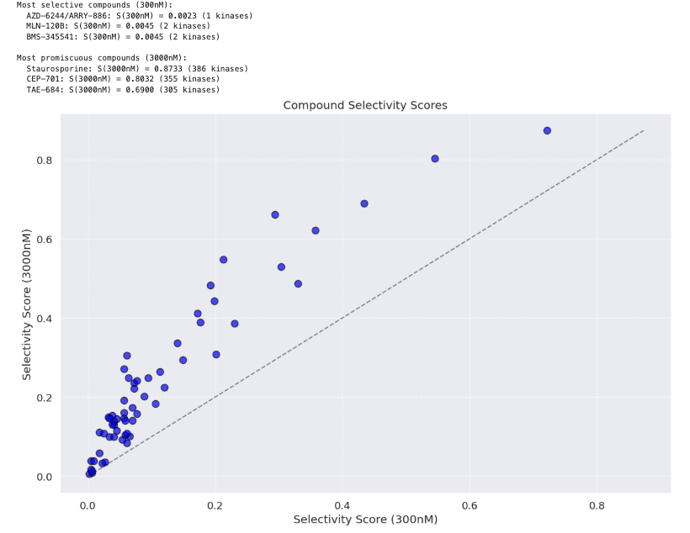
Highest/Lowest Ranked Compounds

Slide 31
All models show Relative MSE values > 1, indicating challenges in accurately predicting selectivity scores:
Model | S(300) Rel. MSE | S(3000) Rel. MSE | Best At
Regression | 1.1376 | 2.4987 | Neither threshold
300 nM Classification | 1.0131 | 1.7535 | S(300) prediction
3000 nM Classification | 1.9362 | 1.1110 | S(3000) prediction

Slide 32
Discussion

Slide 33
Selectivity Classification Patterns/Limitations
Regression model: Most balanced distribution, with 38 low, 19 medium, and 3 high selectivity compounds
300 nM model: Strongly biased toward "Low" (58 compounds) with only 2 "High" and no "Medium"
3000 nM model: Still biased toward "Low" (53 compounds) but predicted 7 "High"

Slide 34
Key Observations of Visualizations
Binary Predictions: All models tend to predict either very low (~0) or very high (~0.85) selectivity, with few intermediate values. This suggests the models struggle with nuanced predictions.
S(300) vs. S(3000) Correlation: The bottom-left plot for each model shows a strong correlation between predicted S(300) and S(3000), which is biologically reasonable.
Mismatch Patterns: In all models, there are compounds with moderate true selectivity (~0.4-0.6) that are predicted as either very selective or not selective at all.
Specialization Effect: Each classification model performs best on its trained threshold (300 nM model better at S(300), 3000 nM model better at S(3000)).

Slide 35

Thank
You!

